Slide 1
Software Testing
Viswanathan Hariharan

Slide 2
Contents
Introduction
Definitions
Types of testing
Role of testing
Test planning & execution
Page 2

Slide 3

Introduction
“Program testing can show presence of a bug, but never their absence” – Dijkstra
(Father of GoTo less programming)
This is especially true in large & complex software
Yet, software testing is a critical part of the software process
Page <number>

Slide 4


Introduction…
Humphrey says “Testing is like weeding a garden: Individual bugs can be found with tests but more powerful methods are needed for the thicket”
Generally 50-80% modules are error-free after deployment
Page <number>

Slide 5

Verification & Validation
Definition by Myers (Author of classic “Art of Software Testing”)
Verification: An attempt to find error in a test / simulated environment
Validation: An attempt to find errors in real environment
Glenford Myers (born December 12, 1946) is an American computer scientist, entrepreneur, and author. He founded two successful high-tech companies (RadiSys and IP Fabrics), authored eight textbooks in the computer sciences, and made important contributions in microprocessor architecture
Page <number>

Slide 6
Testing & Debugging
Testing: Process of executing a program with the intention of finding error
Debugging: Diagnosing & correcting the error
Page <number>

Slide 7
7 types of software tests
Unit / module test
Integration test
Functional testing
Regression testing
  To test if addition of new functionality has affected previously working functions
  May need automation
  May run a subset of previously executed tests
System testing
Acceptance testing
Installation test
Page <number>

Slide 8
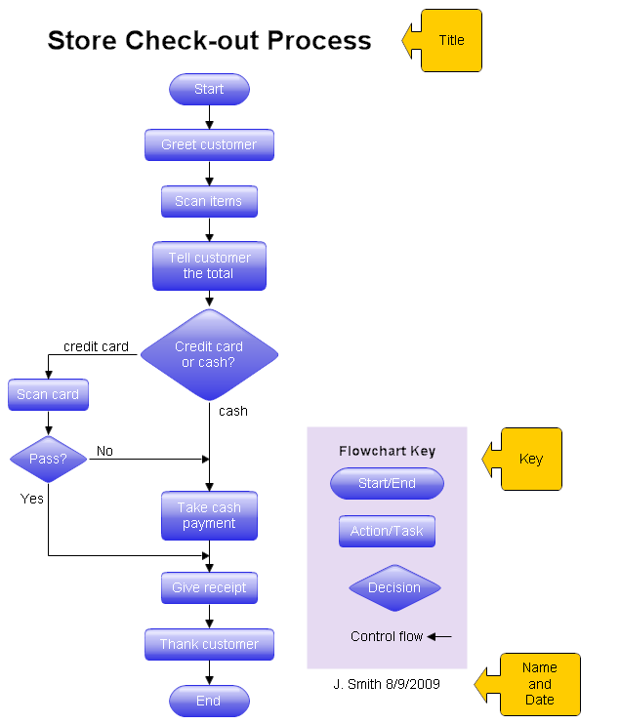
Testing methods
White Box testing: Tests the program with the knowledge of the internal design of the program (internal structure such as if.. Then .. Else, Loops, etc.)
Black box testing: Is based on functional requirements
Page <number>

Slide 9
Software testing principles
With large systems, more tests will find more bugs. So the question is, when do we stop testing
DeMarco says that “No amount of testing can detect more than 50% of the defects”
Hence the objective should be remove as many defects as possible before we reach testing stage
Page <number>

Slide 10
Axioms of testing
Write test cases for valid & invalid condition
  Ex. In a banking application that supports the function of transferring money from Account A to Account B, test the software for transferring say Rs 1000 from account A to B when the balance in A is > 1000 and also when the balance is less than Rs 1000.
Page <number>

Slide 11
Proper role of testing
Myers points of that programs / modules that have the most bugs in test are the most likely source of future problems
Hence testing should be viewed as a search for symptoms pointing to problematic modules (modules with poor design)
One could then do a deeper review of the modules to decide how to improve their quality – either by fixing the error or re-writing completely
Page <number>

Slide 12
Unit testing (White box)
The idea is to test every path in the program for every possible value of parameters
But this being impractical, one resorts to testing every decision statement at least once
“Comprehensive path & parameter testing can catch 72.9% of the defects” – Thayer & Lipow
Page <number>

Slide 13
Integration testing
Pre-requisite is to have a framework to run various elements / modules
Approaches
In a large software, integration testing happens in several steps
Few closely interacting modules are put together to carry out the first round of integration test.
Once the issues are resolved, a few more are added to the previous integration test structure
This goes on till all modules are integrated
Big bang integration is not recommended because debugging a symptom is very difficult
Page <number>

Slide 14
System test
Myers says “If you do not have written objectives for your product, or if your objectives are not measurable, then one can not perform a system test”
  Ex. of objective: When a new customer is created, the system should generate Customer ID which is a combination of Year and a sequence number
  Ex. of immeasurable objective: “The response time should be very good”, “The system should not crash when a large number of users login”
Since System test should check if end users’ needs are met, it should to be carried out by people who have a direct link to end users (ex. people who gathered the requirement)
System test should also focus on
  Performance
  Security
  Usability
  Volume
Page <number>

Slide 15
Test planning
Should start during requirement phase
Test plan should contain
  Test objective (Functional testing, Performance testing, etc..)
  Test environment – hardware, software, networking, bandwidth
  Test tools, if any
  Procedure & tools for recording test results
  Test success criteria (Ex. No severity 1 defects, less than 3 severity 3 defects)
Page <number>

Slide 16
Bug classification
Bugs can be classified based on severity
Example:
Severity 1: Prevents accomplishment of mission-critical function (ex. Transfer funds does not update balance correctly)
Severity 2: Adversely affects accomplishment, but a work around exists (Ex. We need a daily transaction report that is sorted by timestamp, but the system sorts by customer)
Severity 3: Inconveniences the user (Ex. the user needs to enter telephone # twice)
Page <number>

Slide 17
Test execution
Programmers are generally incapable of finding errors in their own programs
Hence it is a good practice to have an independent testing team
Page <number>

Slide 18
Questions & Homework
In your project / organization, is there a concentration of defects in a few modules or are they evenly spread across all modules?
What approach is used to carry out integration testing in your organization?
Read about Test automation tools for regression testing, performance testing – HP Unified Functional test tool (earlier called QTP), Load Runner
Page <number>

Slide 19
Appendix
Page <number>

